Slide 1
论文阅读
傅旭洲
2018.6.20

Slide 2
Dense Semantic Labeling of Very-High-Resolution Aerial Imagery and LiDAR with Fully-Convolutional Neural Networks and Higher-Order CRFs
Yansong Liu, Sankaranarayanan Piramanayagam, Sildomar T., Monteiro Eli Saber
Rochester Institute of Technology 罗彻斯特理工大学
CVPR 2017

Slide 3
数据以及数据处理
数据集：ISPRS labeling contest Potsdam dataset
训练集：
21张图片通过随机裁剪生成36000张224*224的图片，其中只用了IR, R, G三个波段
(Specifically, we generated 36,000 images and corresponding ground truth of size 224 × 224 from the 21 training images by image tiling randomly cropping, and choosing extra data for car category for data balancing. )
测试集：
14张图片裁剪的成224*224的图像，步长为112

Slide 4
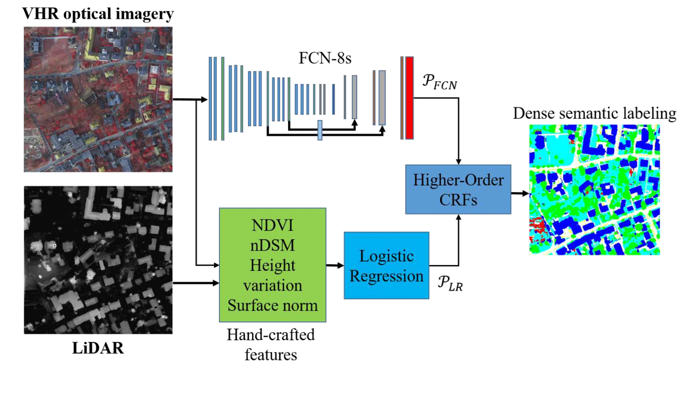
网络结构

Slide 5
特殊之处
FCN训练两次，第一次1e-3的学习率，第二次1e-5的学习率
非固定的方式将两个分类器的概率输出结合起来，而通过高阶CRF学习了训练数据的融合权重。
Gradient-based segmentation

Slide 6
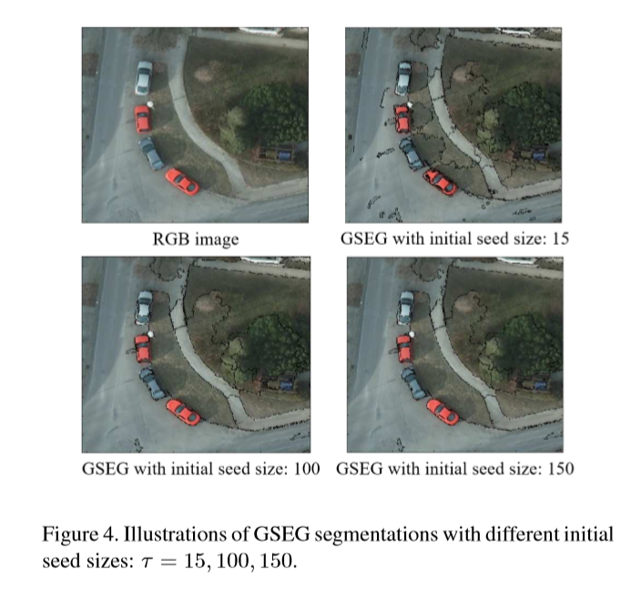
Gradient-based segmentation

Slide 7
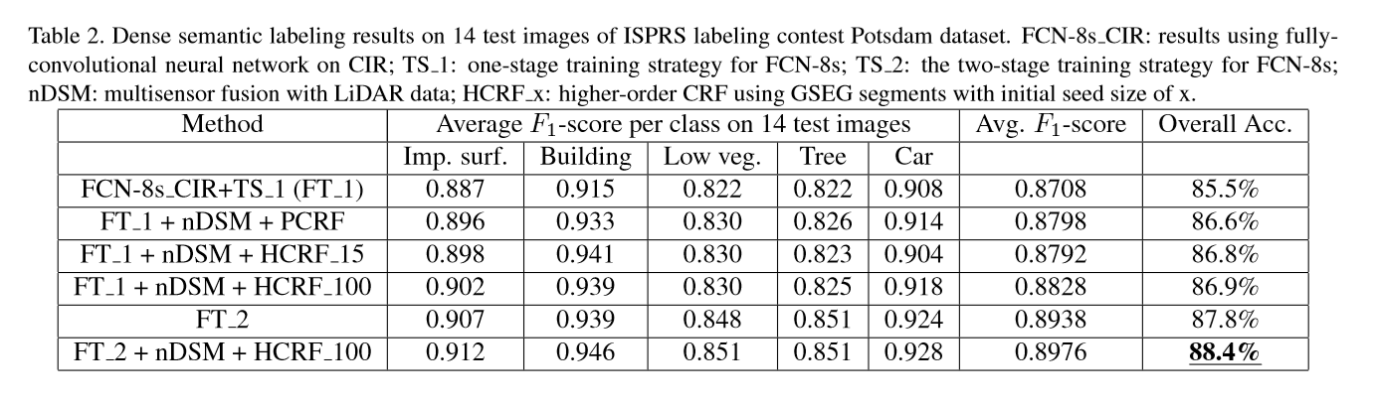
实验结果

Slide 8
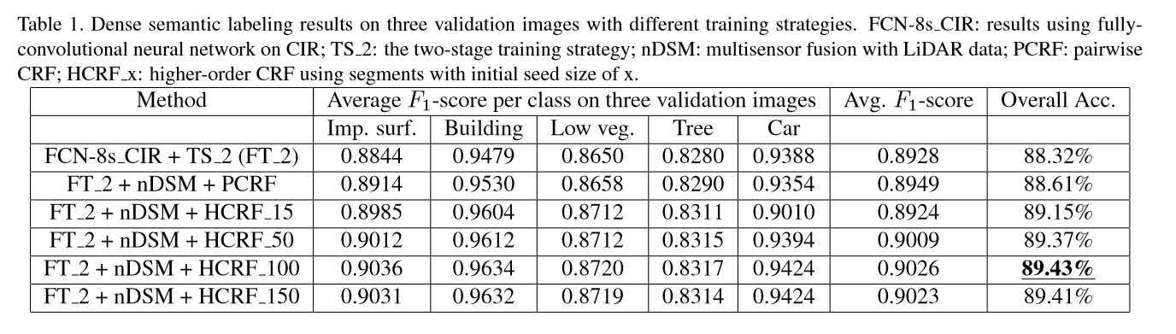
实验结果

Slide 9
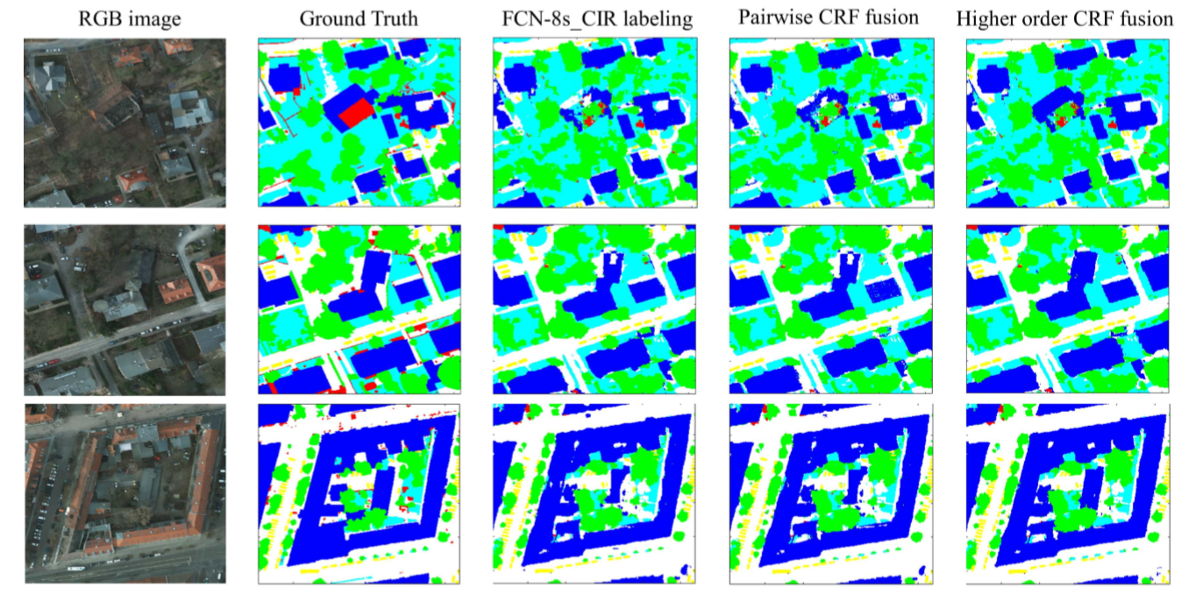
实验效果图

Slide 10
Cloud Detection From RGB Color Remote Sensing Images With Deep Pyramid Networks.
作者：Savas Ozkan, Mehmet Efendioglu, Caner Demirpolat
TUBITAK Space Technologies Research Institute Remote Sensing Group Ankara, Turkey
Arxiv 2018.1

Slide 11
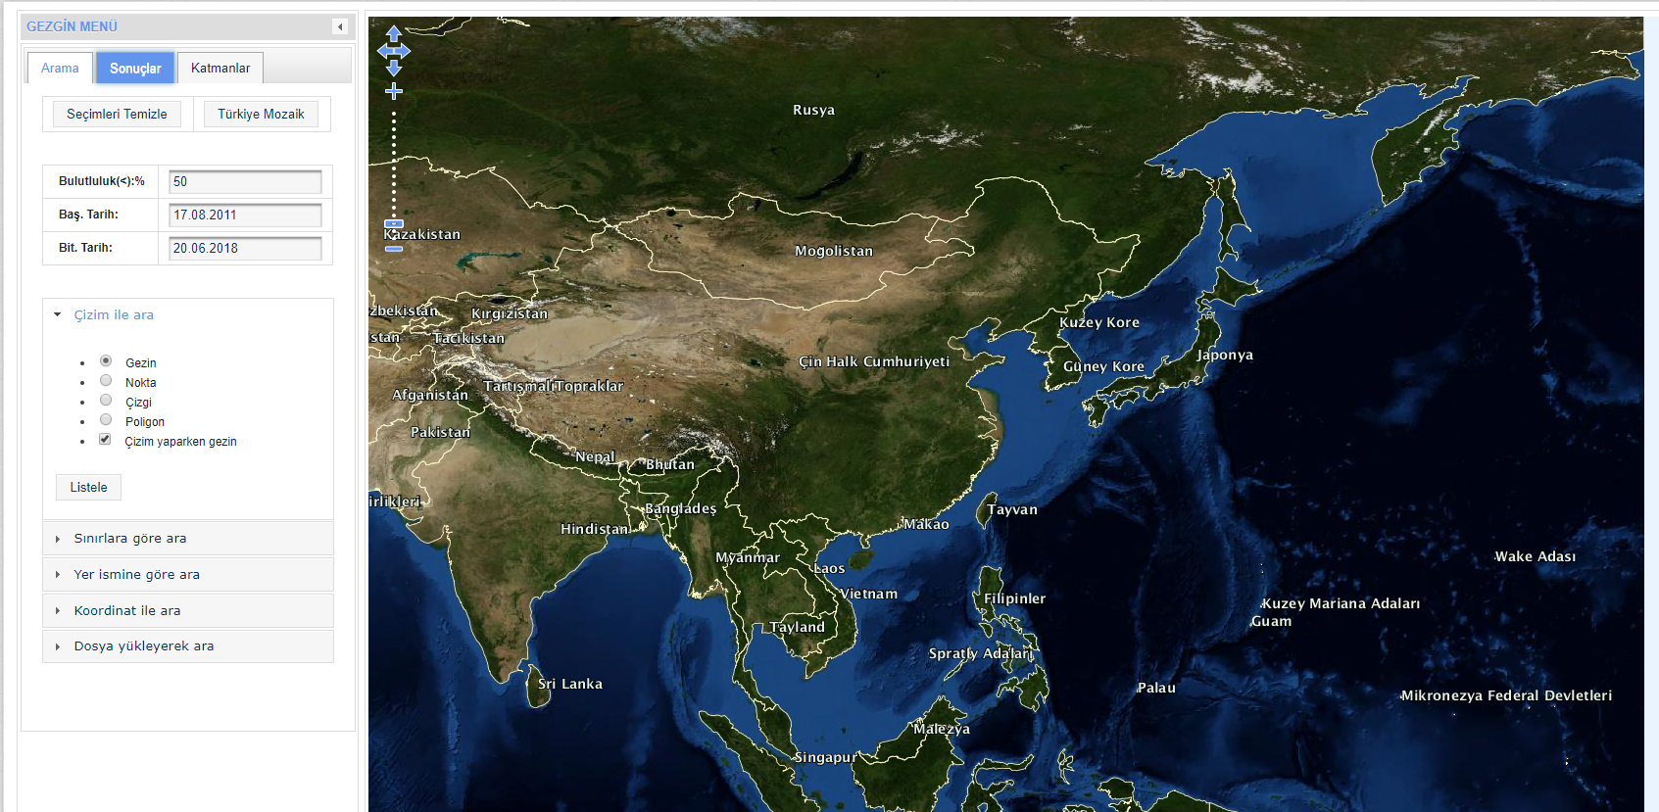
数据集
https://gezgin.gov.tr/

Slide 12
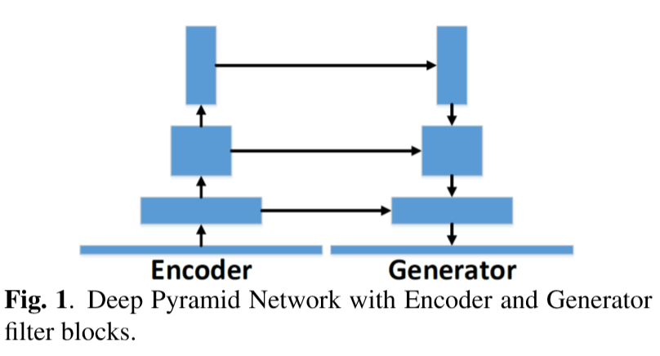
网络结构

Slide 13
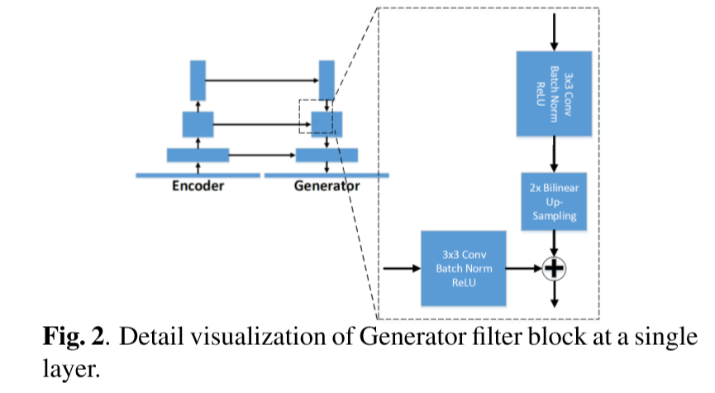
网络结构

Slide 14
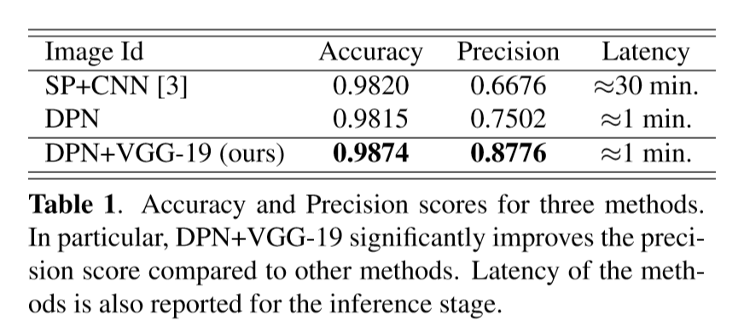
实验结果

Slide 15
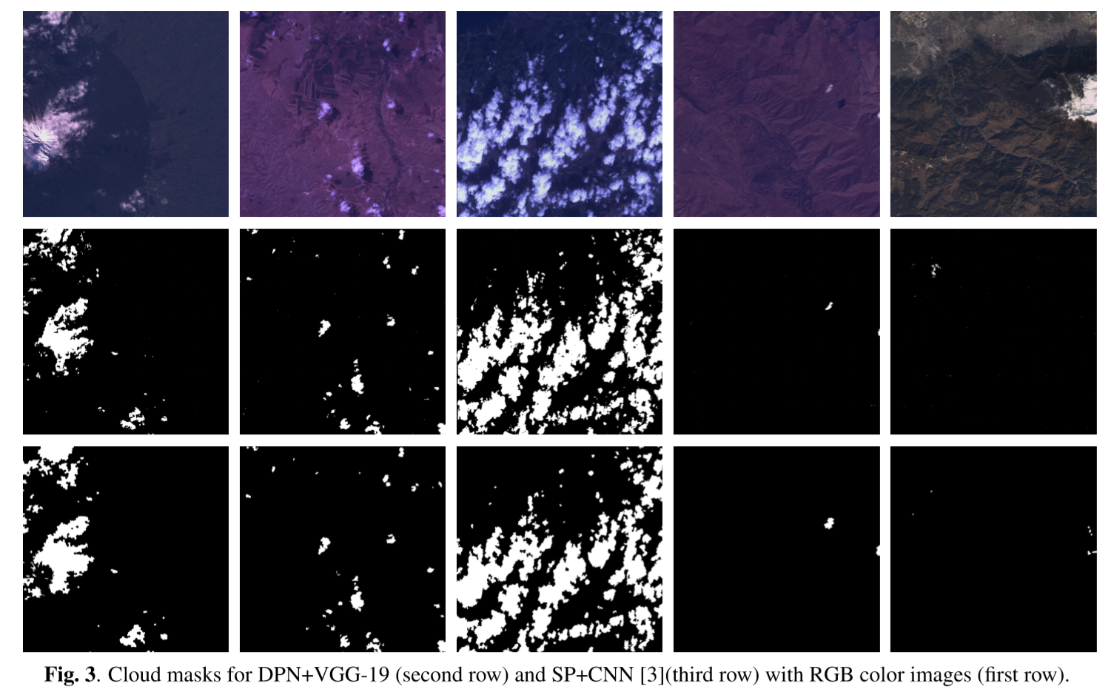

Slide 16
Classification with an edge: improving semantic image segmentation with boundary detection
D. Marmanisa,c, K. Schindlerb, J. D. Wegnerb, S. Gallianib, M. Datcua, U. Stillac
德国航空航天中心
ISPRS Journal of Photogrammetry and Remote Sensing 2017

Slide 17
数据集
ISPRS Vaihingen 2D semantic labeling challenge
(http://www2.isprs.org/commissions/comm3/wg4/2d-sem-label-vaihingen.html)
33 张分辨率约为2500×2000的图片，
其中16张作为训练集，17张作为测试集。

Slide 18
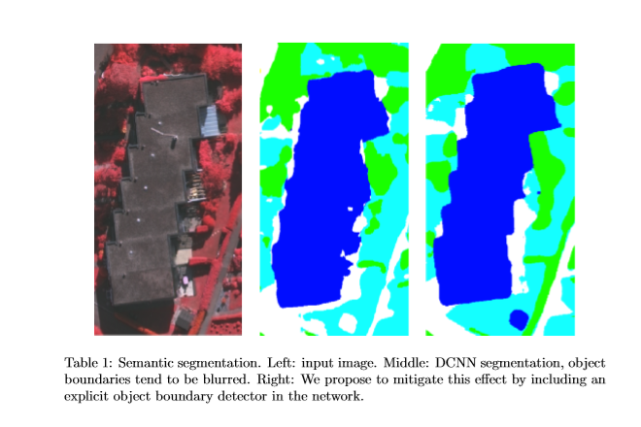

Slide 19
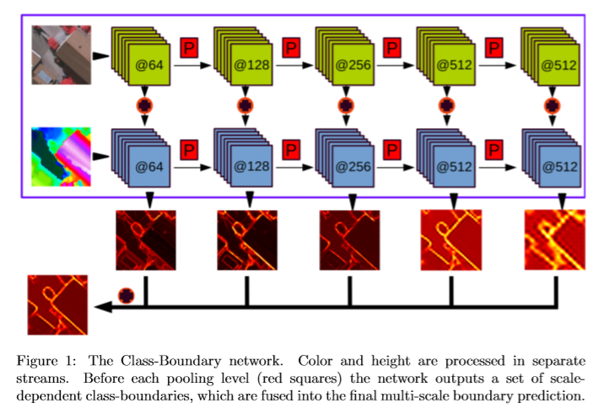
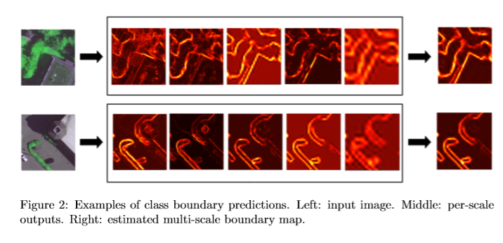
边界检测网络

Slide 20
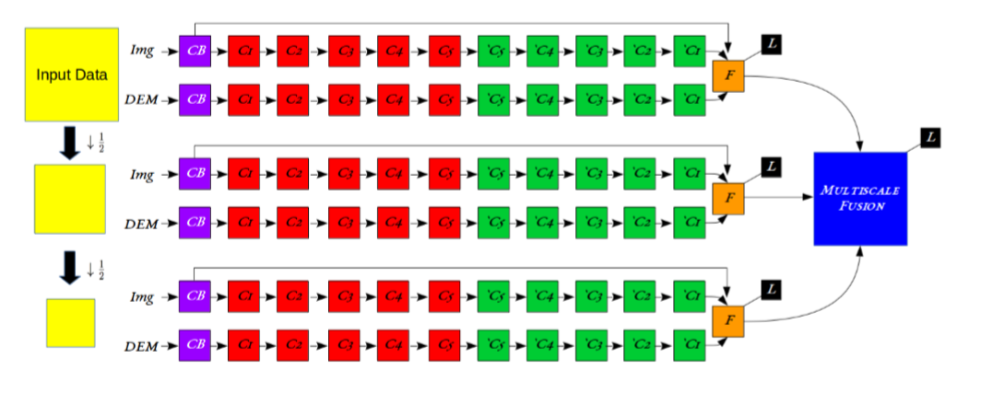
网络结构-基于SegNet

Slide 21
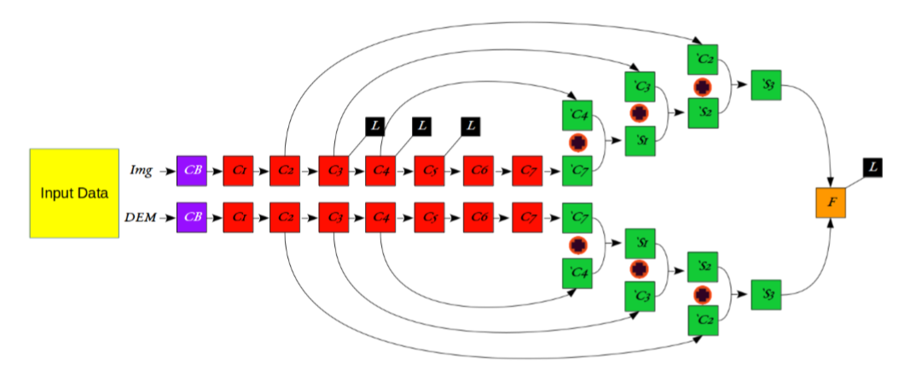
网络结构-基于FCN

Slide 22
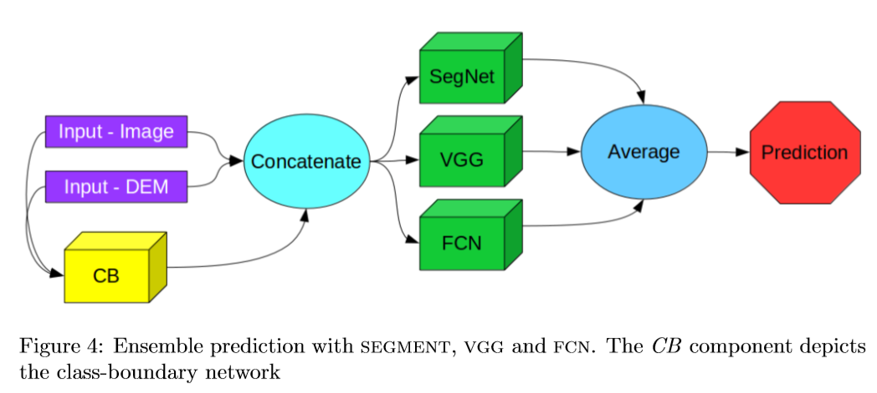
集成

Slide 23
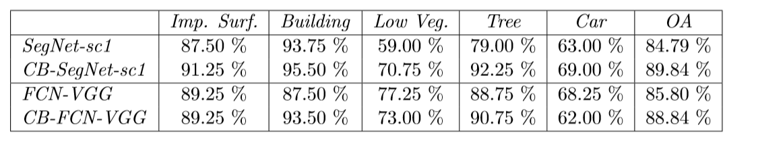
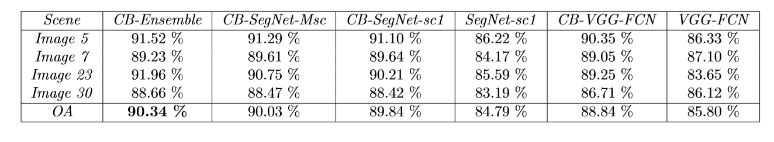

Slide 24
DeepLab: Semantic Image Segmentation with Deep Convolutional Nets, Atrous Convolution, and Fully Connected CRFs
Liang-Chieh Chen, George Papandreou, Senior Member, IEEE, Iasonas Kokkinos, Member, IEEE, Kevin Murphy, and Alan L. Yuille, Fellow, IEEE
Google
T-PAMI 2018
数据集 PASCAL VOC 2012

Slide 25
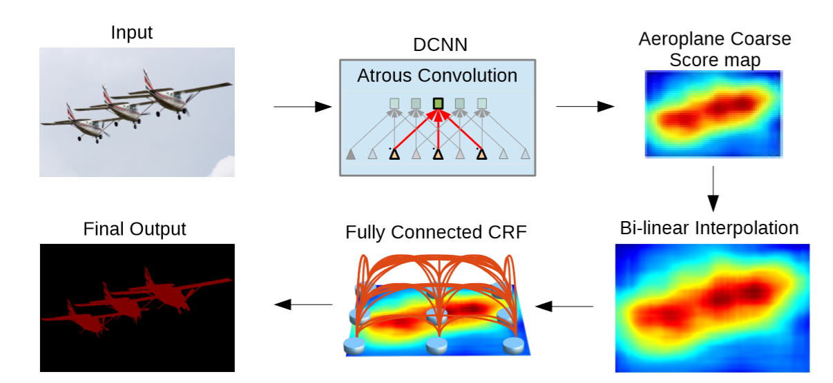

Slide 26
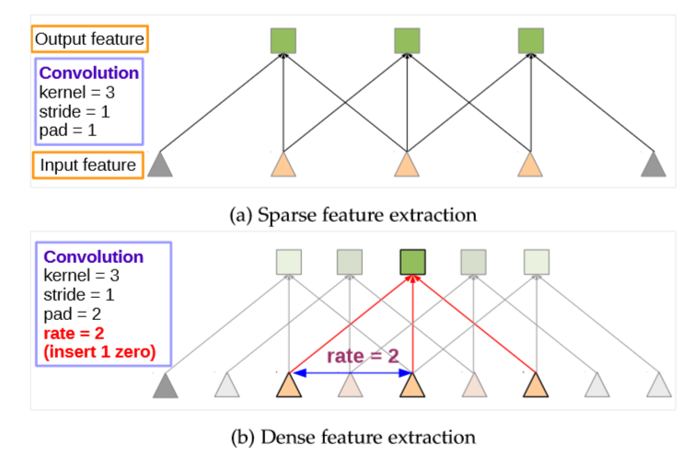
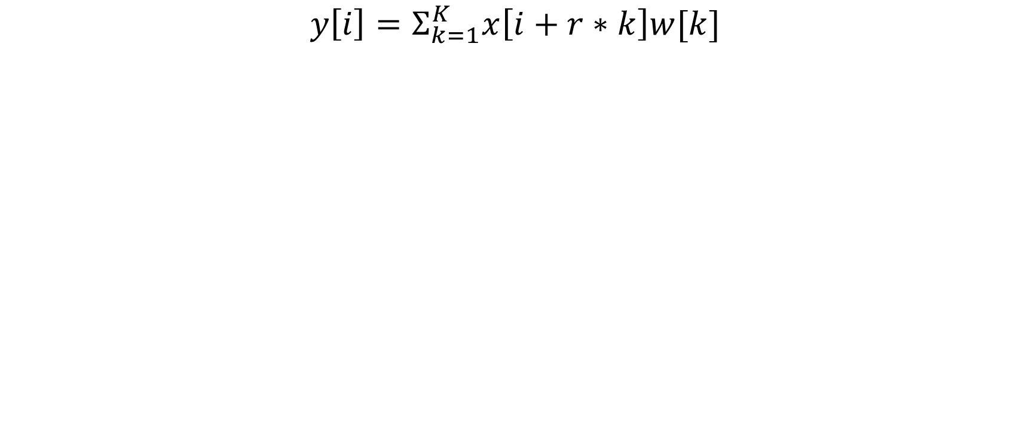
Atrous Convolution
$$y\left[i\right]=Σ_{k=1}^{K}x\left[i+r∗k\right]w[k]$$

Slide 27
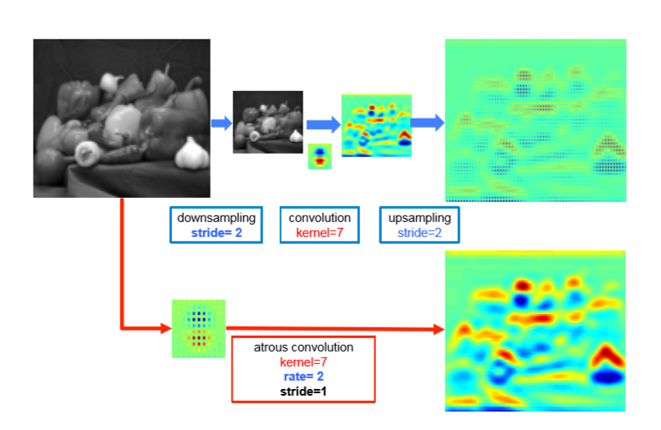

Slide 28
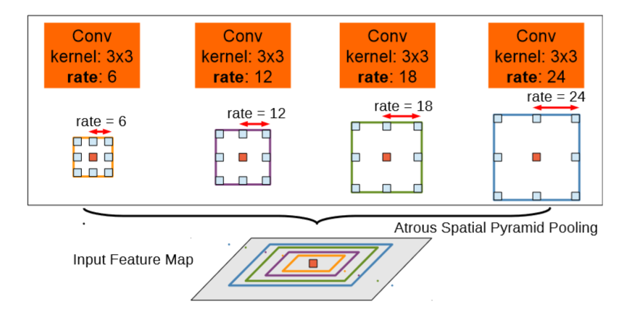
Atrous Spatial Pyramid Pooling

Slide 29
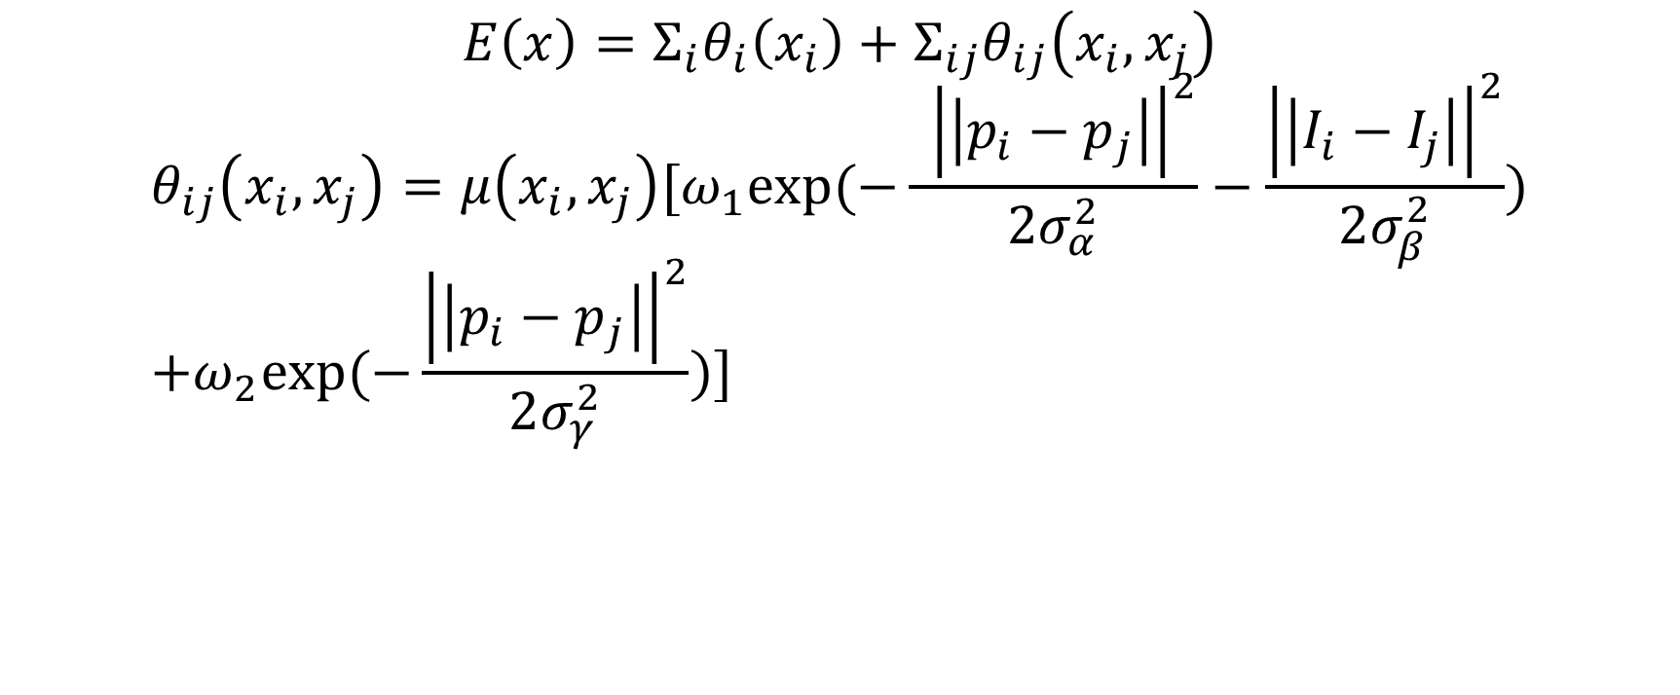
CRF
$$E\left(x\right)=Σ_{i}θ_{i}\left(x_{i}\right)+Σ_{ij}θ_{ij}\left(x_{i},x_{j}\right)$$
$$θ_{ij}\left(x_{i},x_{j}\right)=μ\left(x_{i},x_{j}\right)[ω_{1}exp⁡(−\frac{ {\left|\left|p_{i}−p_{j}\right|\right|}^{2}}{2σ_{α}^{2}}−\frac{{\left|\left|I_{i}−I_{j}\right|\right|}^{2}}{2σ_{β}^{2}}) \\ +ω_{2}exp⁡(−\frac{{\left|\left|p_{i}−p_{j}\right|\right|}^{2}}{2σ_{γ}^{2}})]$$

Slide 30
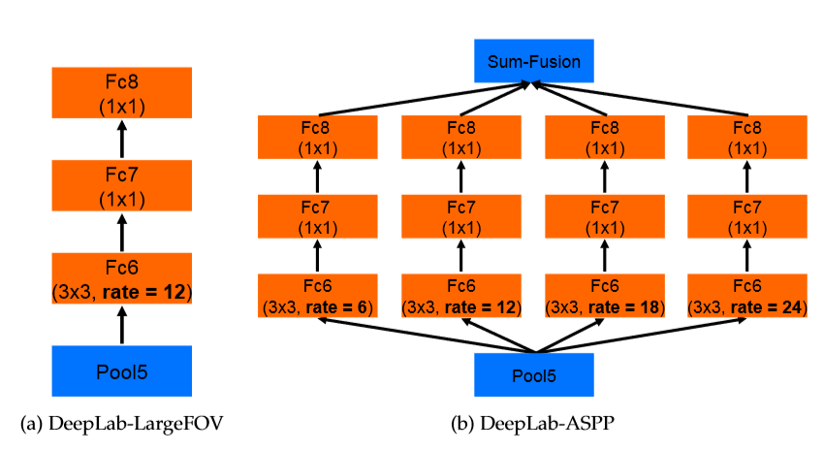
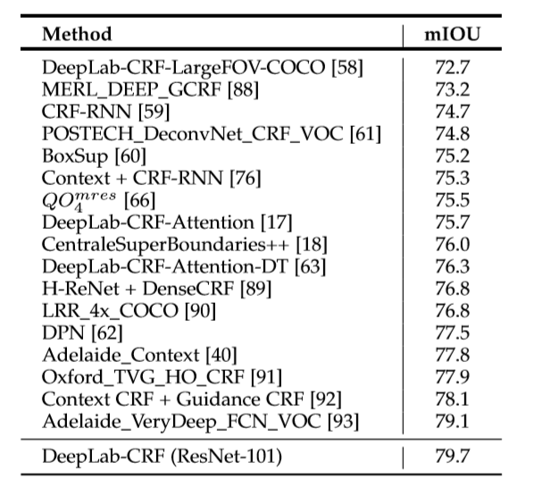
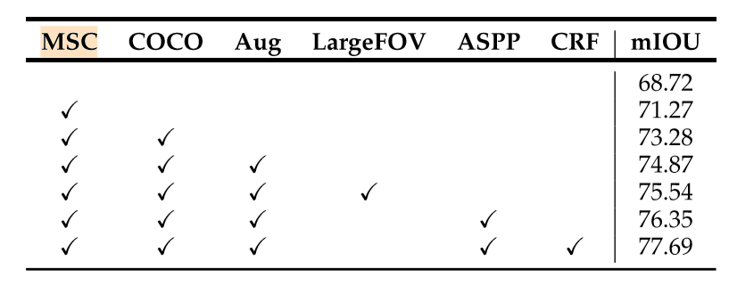

Slide 31
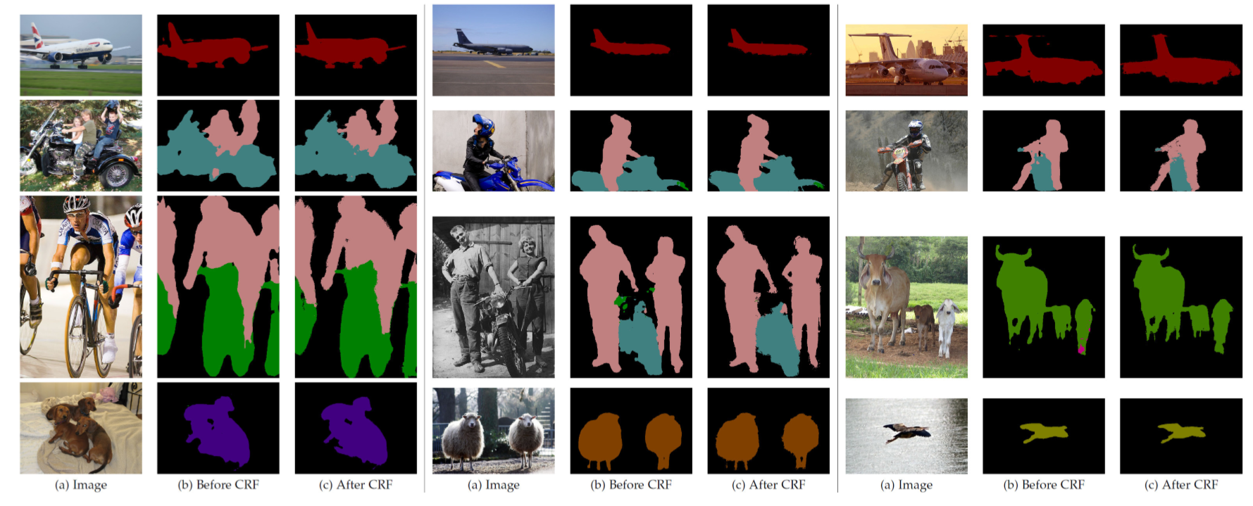

Slide 32
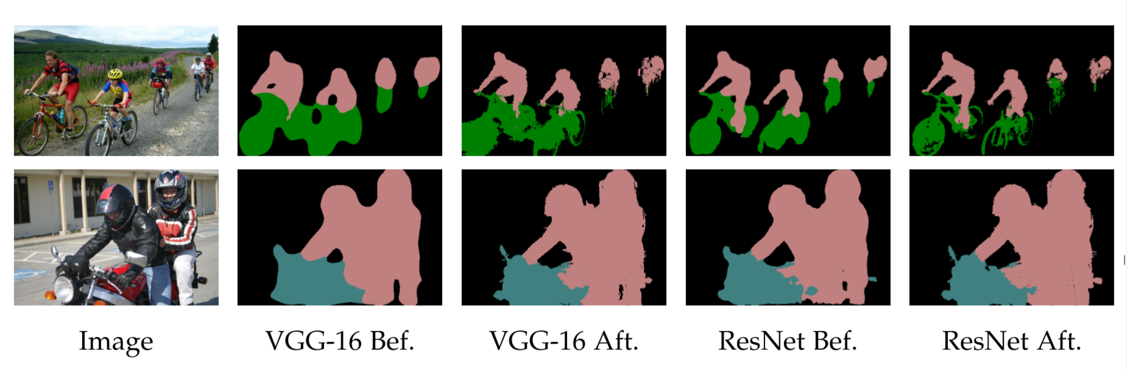

Slide 33
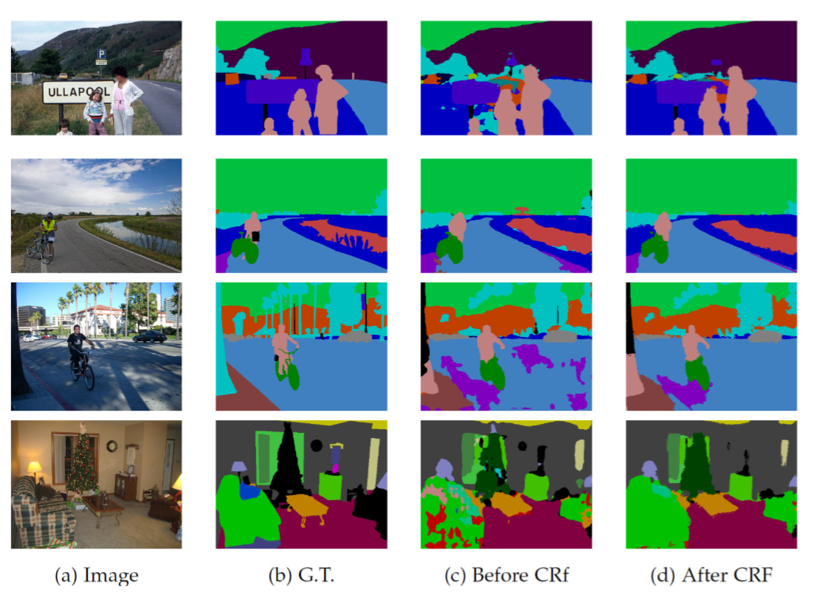

Slide 34
